Slide 1
Wave propagation speed in neural columns
Vincent Baker
Drexel University Department of Physics

Slide 2
Plan (from last time)
Plotted wave speed against delay parameter and connectivity parameter. Need to investigate region around λ=3.5 that showed faster propagation
Found that the pattern holds. Wave behavior changes above λ=4, a single impulsive stimulus now creates an initial wave followed by “echo” waves

Slide 3
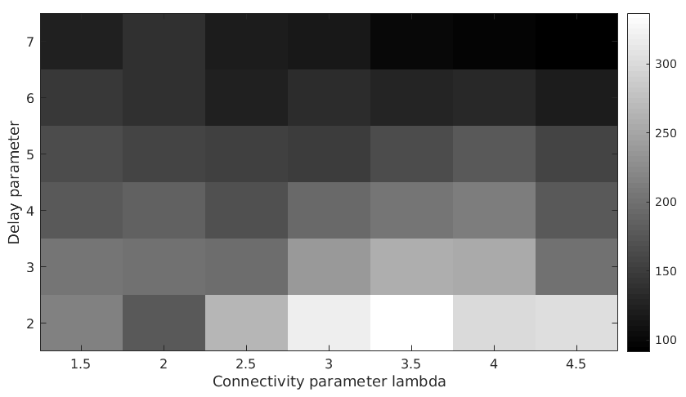
Wave speed
For inter-neuron distance d:
Connection probability exp(-(d/ λ)^2)
Propagation delay κd
Wave speed decreases with increasing κ
Seems to be a region of higher speed around λ=3:3.5, need to investigate
Wave speed (units/sec)
Region of higher speed
Add parameter letters

Slide 4
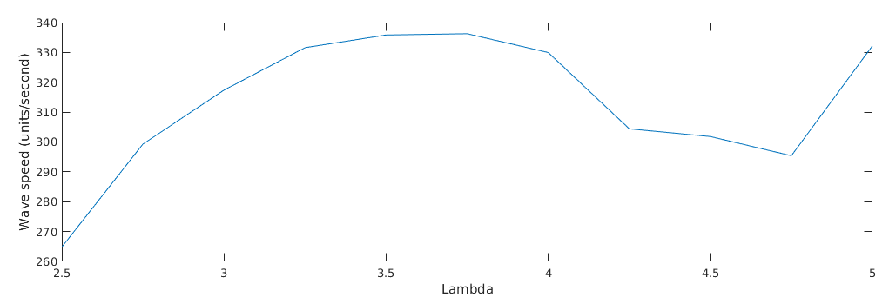
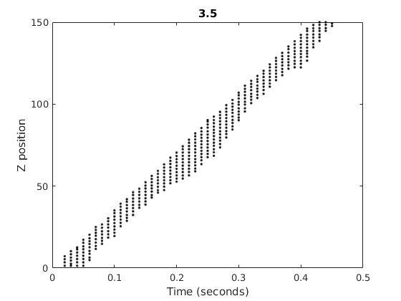
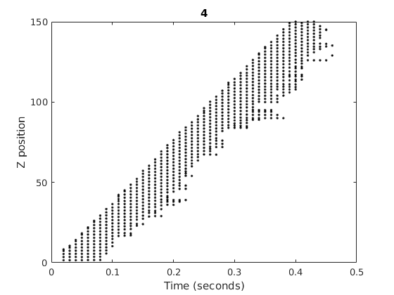
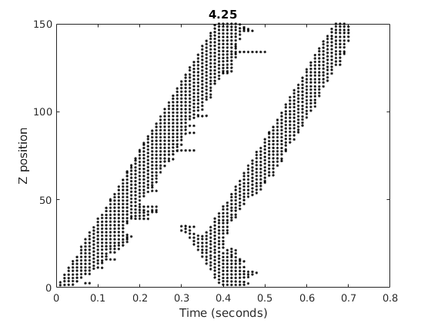
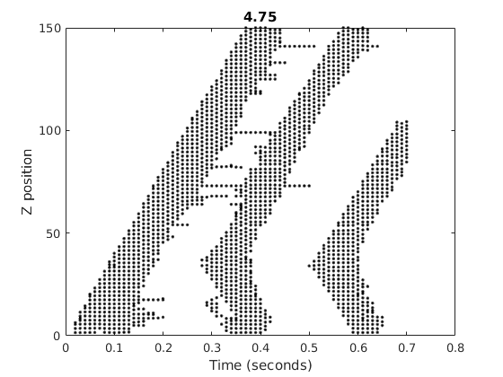
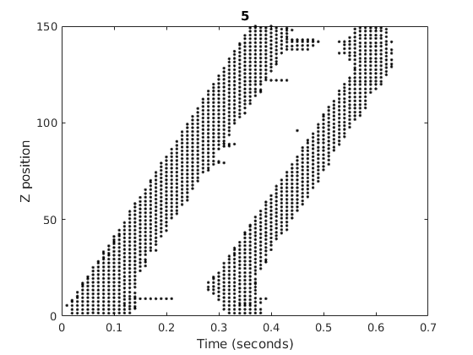
Detail of region (κ = 2)

Slide 5
Notes
Investigate connectivity distance on speed and wave re-initiation. If we suppress long-range connections, does that suppress secondary firings?
Back to initiation (why?). Connectivity? Inhibition?

